Slide 1
Design Patterns
Command

Slide 2
Agenda
Command Pattern
  Head First Example (Remote Control)
  Lab
  History of Undo Operations
  Simple Logging
  Complex Logging
  Case Study: Command Management
  Distributed Command Pattern

Slide 3
Remote Control
Given remote control with seven programmable slots.
A different device can be put into each slot.
There is an On and Off switch for each device slot.
Global Undo button undoes the last button pressed.
Also given a CD with different vendor classes that have already been written (for the different devices, TV, Light, Sprinkler, etc)

Slide 4
First Thoughts
We know that there are seven programmable slots for different devices…so each device may possibly adhere to some common interface.
We know that we need to turn each device “on” or “off”..so that needs to be commonly done for any device.
Undo needs to work for any device as well.

Slide 5
What Varies? What stays the same?
What Varies
  The actual device assigned to a slot
  The instruction for “On” on a specific device
  The instruction for “Off” on a specific device
What Stays the Same
  Device with seven slots
  Capability to assign a slot to a device
  Capability to request that a device turn On or Off
  Capability to undo the last action requested against the device

Slide 6
The Vendor Classes (pg 194)
Vendor classes have been provided to us via a CD.
  Ceiling Light
  TV
  Hottub
We know that each device needs an “On” or “Off” state.
  Since the capability to turn a device “On” or “Off” is something that “stays the same”.
  However, each vendor class has their own unique way of doing “On” or “Off”.

Slide 7
One possible solution…
if (slot1 == Light)
light.on();
Else if (slot1 == Hottub) {
hottub.prepareJets();
hottub.jetsOn();
} Else if (slot1 == TV)
tv.on();
etc
Problems:
The Remote needs to be aware of all the details about turning a device on (or off).
If device On/Off mechanism changes, the Remote code will need to be changed.
If a new device is added, this code would need to be changed.
Is this Open for Extension??
Also…what about undo????

Slide 8
Separation of Concerns
The Vendor Class
  One (or more) methods that define “On”
  One (or more) methods that define “Off”
The Command
  Sends a message to a device (On or Off)
  Handle the undo of a message
  Possible future enhancements
    Logging request
    Queue request
The Remote – handles one or more Commands. The Remote doesn’t know anything about the actual vendor class specifics.

Slide 9
The Command Pattern
“Allows you to decouple the requestor of the action from the object that performs the action.”
“A Command object encapsulates a request to do something.”
  Note: A Command object handles a single request.

Slide 10
Command Interface (pg203)
public interface Command {
public void execute();
}
The Command interface (in this example) just does one thing..executes a command.

Slide 11
LightOnCommand (pg203)
public class LightOnCommand implements Command {
Light light;
public LightOnCommand(Light light) {
this.light = light;
}
public void execute() {
light.on();
}
}
The command is composed of a vendor class.
Constructor takes the vendor class as parameter.
Here the command delegates execution to the vendor class.
Note: This is a simple example..there could be more steps.

Slide 12
SimpleRemoteControl (pg204)
public class SimpleRemoteControl {
Command slot;
public SimpleRemoteControl() {}
public void setCommand(Command command) {
slot = command;
}
public void buttonWasPressed() {
slot.execute();
}
}
This version of the remote just has one slot.
setCommand assigns a Command to a slot.
Tells the command to execute. Note that any command would work here. The remote doesn’t know anything about the specific vendor class.

Slide 13
RemoteControlTest (pg204)
SimpleRemoteControl remote = new SimpleRemoteControl();
Light light = new Light();
GarageDoor garageDoor = new GarageDoor();
LightOnCommand lightOn =
new LightOnCommand(light);
GarageDoorOpenCommand garageOpen =
new GarageDoorOpenCommand(garageDoor);
remote.setCommand(lightOn);
remote.buttonWasPressed();
remote.setCommand(garageOpen);
remote.buttonWasPressed();
Create two vendor classes.
Create two commands based on these vendor classes.
Set the command and press button

Slide 14
The Command Pattern
GoF Intent: “Encapsulates a request as an object, thereby letting you parameterize other objects with different requests, queue or log requests, and support undoable operations.”
See diagrams on pg 206
  Command encapsulates a Receiver object
  Different commands can fit into a Remote Slot (which exists in the Remote Control)

Slide 15
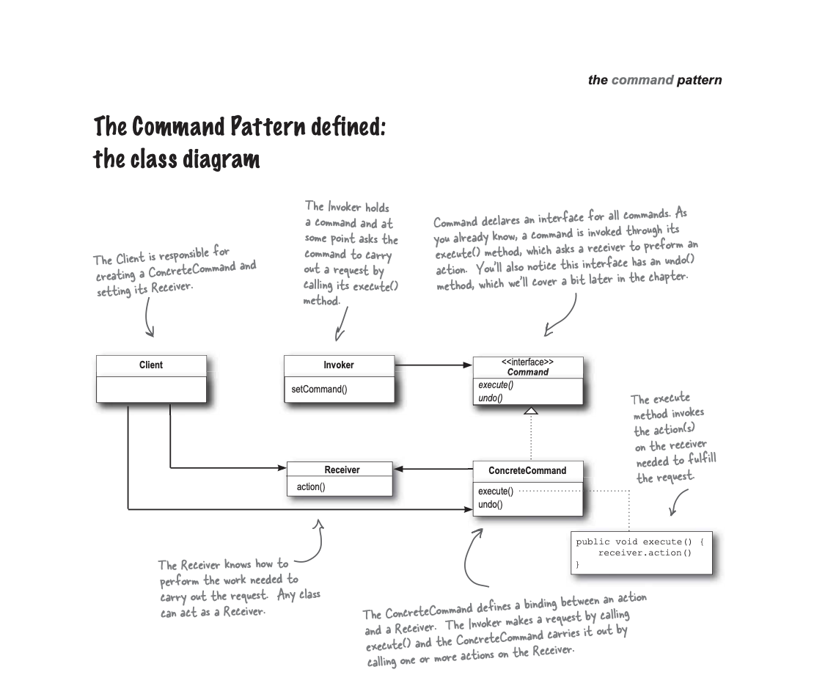

Slide 16
Definitions (see Diagram on pg 207)
Client (RemoteControlTest) – creates command and associates command with receiver.
Receiver (TV, HotTub, ec)– knows how to perform the work.
Concrete Command (LightOnCommand) - implementation of Command interface
Command Interface – defines interface for all commands.
Invoker (Remote Control) – holds reference to a command and calls execute() method against it.

Slide 17
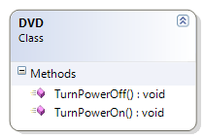
Lab Part I
We get a new vendor class for DVD. To turn on the DVD, call the function TurnPowerOn(). To turn off, you call TurnPowerOff().
Create an On and Off command object for the DVD player.

Slide 18
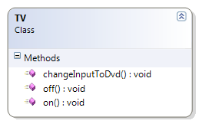
Lab Part II
The customer wants to be able to turn the DVD and TV on (and off) at the same time.
Create a command that will set up the DVD and TV with one button click.

Slide 19
Lab Part III (Design Challenge!)
Look at the LightOnCommand and LightOffCommand on pg 217.
Note that there is a duplication of code between these two objects.
Can you create an abstract class called Command that can help remove this duplication of code…and yet support Undo??

Slide 20
Lab Part I Answer
public class DVDOnCommand : Command {
DVD dvd;
public DVDOnCommand(DVD d)
{
this.dvd = d;
}
public void execute()
{
dvd.TurnPowerOn();
}
}

Slide 21
Lab Part I Answer (cont)
public class DVDOffCommand : Command {
DVD dvd;
public DVDOffCommand(DVD d)
{
this.dvd = d;
}
public void execute()
{
dvd.TurnPowerOff();
}
}

Slide 22
Lab Part II Answer
public class DVDTvOnCommand : Command {
DVD dvd;
TV tv;
public DVDTvOnCommand(DVD d, TV t)
{
this.dvd = d;
this.tv = t;
}
public void execute()
{
tv.on();
tv.changeInputToDvd();
dvd.TurnPowerOn();
}
}

Slide 23
Lab Part III (Answer)
public enum CommandState
{
NOTSET,
ON,
OFF
}

Slide 24
Lab Part III (Answer)
public abstract class CommandBase
{
CommandState state;
public CommandBase()
{
state = CommandState.NOTSET;
}
abstract protected void executeOn();
abstract protected void executeOff();

Slide 25
public void on() {
state = CommandState.ON;
executeOn();
}
public void off() {
state = CommandState.OFF;
executeOff();
}
public void undo() {
if (state == CommandState.ON)
off();
else if (state == CommandState.OFF)
on();
else if (state == CommandState.NOTSET)
{
//do nothing
}
}
We don’t want on(), off(), and undo() to be overridden.

Slide 26
Lab Part III
public class LightCommand : CommandBase
{
Light light;
public LightCommand(Light l) {
this.light = l;
}
protected override void executeOn()
{
light.on();
}
protected override void executeOff()
{
light.off();
}
}

Slide 27
Lab Part III
The client that calls this code…
CommandBase c = new LightCommand(new Light());
c.on();
c.undo();

Slide 28
History of Undo Operations
If the Undo button is pressed multiple times, we want to undo each command that had been previously applied.
Which object should we enhance to store a history of each command applied? Why?
  Client (RemoteControlTest)
  Receiver (TV, DVD, etc)
  ConcreteCommand (LightOnCommand, LightOffCommand, etc)
  Invoker (RemoteControl)
We need to be able to add commands to a list and then later get the most recent one. What kind of object can we use?

Slide 29
History of Undo Operations
public class RemoteControl {
Stack<Command> undoStack; //this gets initialized in //constructor.
public void onButtonWasPushed(int slot) {
onCommands[slot].execute();
undoStack.push(onCommands[slot]);
}
public void offButtonWasPushed(int slot) {
offCommands[slot].execute();
undoStack.push(offCommands[slot]);
}
public void undoButtonWasPushed() {
Command c = undoStack.pop();
c.undo();
}

Slide 30
Simple Logging
We want to enhance the Remote Control again to log every time a Command is executed (on or off).
Which object should we enhance??

Slide 31
Simple Logging
Changes to RemoteControl…
public void onButtonWasPushed(int slot) {
onCommands[slot].execute();
//Log here
}
public void offButtonWasPushed(int slot) {
offCommands[slot].execute();
//Log here
}
Advantage: We can add logging in the Invoker. No change is needed in any of the Command or Receiver objects!

Slide 32
Complex Logging
Let’s say we had a spreadsheet application and we know it may crash often.
For failure recovery, we could periodically store a backup of the spreadsheet every 5 minutes...or we could periodically persist the list of commands executed on the spreadsheet since the last save point.
When a crash occurs, we load the last saved document and re-apply the persisted commands.

Slide 33
Complex Logging
public void onButtonWasPushed(int slot) {
onCommands[slot].execute();
StoreToDisk(onCommands[slot]);
}
public void offButtonWasPushed(int slot) {
offCommands[slot].execute();
StoreToDisk(offCommands[slot]);
}
public void SaveButtonPressed() {
//Delete stored commands from disk.
}
public void RestoreCommands() {
//load last saved state
Commands[] storedCommands = GetCommandsFromDisk();
//for each Command, call execute()
}
Once again, we can make these changes in one place (the Invoker)

Slide 34
Case Study: Command Management
The File menu contains the items:
Open
Save
Print
Also menu item “Edit → Copy “ which is enabled when text is selected.
Same toolbar buttons for each menu item.

Slide 35
Question
Imagine that there is a Command for each action
  Open
  Save
  Print
  Copy
How would you associate each Menu/Toolbar pair with a Command?

Slide 36
Possible Solutions
In both the Menu and Toolbar click events, write all of the code for performing the command.
(or) Consolidate all of the logic in one place and have the Menu and Toolbar events call the same logic.
What are the disadvantages of this approach?

Slide 37
Disadvantages
The developer would need to enforce that each UI element calls the right command.
Managing state can be become an issue.
  For example, input form with three different UI elements for Save. (Menu Item, Toolbar Button, Button next to the Form)
  When the form is in Edit mode all of these elements should be Enabled. When the form is not in Edit mode, they need to be disabled.
  saveMenuItem.Enabled = false;
  saveButton.Enabled = false;
  saveToolbar.Enabled = false

Slide 38
Command Management Framework
Based on the Command Pattern
Framework for associating multiple UI Elements to the same Command
Can associate UI Elements and Commands in one place.
You can send a message to a Command
  “Tell all of your UI Elements to Turn On or Off”

Slide 39
Example
// Create Command Manager object
cmdMgr = new CommandManager();
//Create a Command “Edit Copy” with a Execute and Copy
//functionality.
cmdMgr.Commands.Add( new Command(
"EditCopy",
new Command.ExecuteHandler(OnCopy),
new Command.UpdateHandler(UpdateCopyCommand)));
//Associate Command “Edit Copy” with different UI elements (Menu and Toolbar)
cmdMgr.Commands["EditCopy"].CommandInstances.Add(
new Object[]{mnuEditCopy, tlbMain.Buttons[4]});

Slide 40
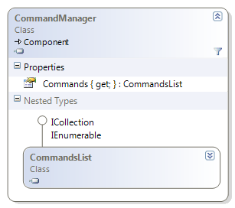
Command Manager
The Commands property contains a list of all possible Commands.
CommandsList contains a List object internally for storing each possible Command. It also has a reference to CommandManager.

Slide 41
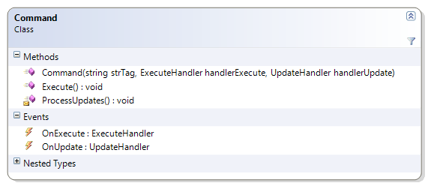
Command Object
ExecuteHandler = delegate that represents the logic for executing the actual Command logic. Triggered when the command is executed. Gets associated with OnExecute event.
UpdateHandler = delegate that represents the logic for executing the logic to update the state of a command. (For example, Edit → Copy should be enabled if text has been selected). Associated with OnUpdate event.

Slide 42
Command Constructor
public Command( string strTag,
ExecuteHandler handlerExecute,
UpdateHandler handlerUpdate)
{
this.strTag = strTag;
OnExecute += handlerExecute;
OnUpdate += handlerUpdate;
}
//Delegates
public delegate void ExecuteHandler(Command cmd);
public delegate void UpdateHandler(Command cmd);
// Events
public event ExecuteHandler OnExecute;
public event UpdateHandler OnUpdate;
Associates events to delegates

Slide 43
Command: Execute() and ProcessUpdates()
// Methods to trigger events
public void Execute()
{
if (OnExecute != null)
OnExecute(this);
}
internal void ProcessUpdates()
{
if (OnUpdate != null)
OnUpdate(this);
}
Will call the function passed in as ExecuteHandler
Will call the function passed in as UpdateHandler
How is this Command.Execute() different than the RemoteControl example??
Notes:
Note: In the RemoteControl example, each Command wrapped a Receiver object and told the Reciever to do something. In this example, the Command is given the logic externally.

Slide 44
Re-look at EditCopy
cmdMgr.Commands.Add( new Command(
"EditCopy",
new Command.ExecuteHandler(OnCopy),
new Command.UpdateHandler(UpdateCopyCommand)));
//Here is the logic of the actual command
public void OnCopy(Command cmd) {
Clipboard.SetDataObject(txtEditor.SelectedText);
}
//Defines the condition for when the command should be “on”
public void UpdateCopyCommand(Command cmd) {
cmd.Enabled = txtEditor.SelectedText.Length > 0;
}
Will discuss later

Slide 45
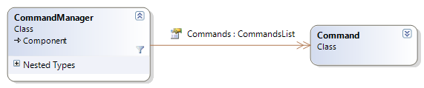
So far..
Command #1
Tag = “Edit Copy”
OnExecute = OnCopy
OnUpdate = UpdateCopyCommand
Command #2
Tag = “File Open”
OnExecute = OnFileOpen
OnUpdate = null

Slide 46
Associating UI Elements to a Command
//Associate Command “Edit Copy” with different UI elements
//(Menu and Toolbar)
cmdMgr.Commands["EditCopy"].CommandInstances.Add(
new Object[]{mnuEditCopy, tlbMain.Buttons[4]});
What object contains the CommandInstances property??

Slide 47
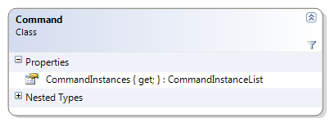
CommandInstances
Contain a list of all UI Elements associated with a Command

Slide 48
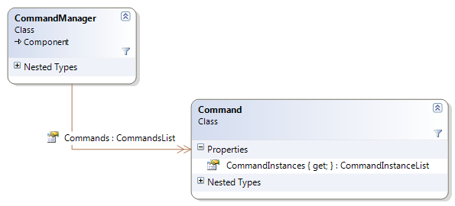
So far..
Two items:
mnuEditCopy
tlbMain.Buttons[4]
Command #1
Tag = “Edit Copy”
OnExecute = OnCopy
OnUpdate = UpdateCopyCommand
All we have done so far is store information…

Slide 49
How do we enable a Command???
In CommandManager, there is an event handler for the Application Idle Event:
private void OnIdle(object sender, System.EventArgs args)
{
IDictionaryEnumerator myEnumerator =
(IDictionaryEnumerator)Commands.GetEnumerator();
while ( myEnumerator.MoveNext() )
{
Command cmd = myEnumerator.Value as Command;
if (cmd != null)
cmd.ProcessUpdates();
}
}
Are you enabled???

Slide 50
Command.ProcessUpdates()
internal void ProcessUpdates()
{
if (OnUpdate != null)
OnUpdate(this);
}
For Edit Copy, the following code will be called:
public void UpdateCopyCommand(Command cmd) {
cmd.Enabled = txtEditor.SelectedText.Length > 0;
}
If we do need to enable (or disable) the Command, who do we need to tell to “go enable/disable yourself?”

Slide 51
Command.Enabled Property
The psuedo-code for this property is the following:
  Enabled = true or false //we got this information externally
  foreach (object in CommandInstances)
  //enable or disable yourself.
  End for
So if there is a Menu Item, ToolBar, etc, we want to enable each one. But note that CommandInstances is just a collection of generic objects…

Slide 52
Command.Enabled (Psuedo-Code)
  foreach (object in CommandInstances)
  if (object is MenuItem) {
  MenuItem m = (MenuItem)object;
  m.Enabled = (true or false);
  } else if (object is Toolbar) {
  Toolbar t = (Toolbar)object;
  t.Enabled = (true or false);
  } else {…}
  End for
Question: Any problems with this code???

Slide 53
Command.Enabled (Psuedo-Code)
  foreach (object in CommandInstances)
  commandExecutor = GetCommandExecutor(typeof(object);
  commandExecutor.Enable( object, true/false);
  End for
Notes:
Possible Side Discussion on Factory?

Slide 54
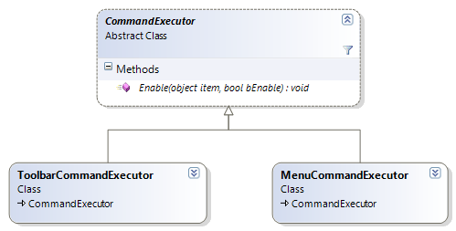
CommandExecutor
Enable() is abstract. Toolbar and Menu subclasses must define how Enable needs to work.

Slide 55
CommandExecutor
public abstract class CommandExecutor
{
public abstract void Enable(object item, bool bEnable);
}
public class MenuCommandExecutor : CommandExecutor
{
public override void Enable(object item, bool bEnable)
{
MenuItem mi = (MenuItem)item;
mi.Enabled = bEnable;
}
}

Slide 56
Command.Enabled (Real Code)
public bool Enabled
{
get
{
return enabled;
}
set
{
enabled = value;
foreach(object instance in commandInstances)
{
Manager.GetCommandExecutor(instance).Enable(
instance, enabled);
}
}
}
CommandManager actually contains all possible CommandExecutors. These are registered during start-up for each possible type of UI element. (CommandManager constructor)

Slide 57
CommandExecutor - Execution
These objects also help establish the connection between the UI Event and a Command.
For example, MenuCommandExecutor establishes a link between the event MenuItem.Click and the associated Command execution method (command.Execute)

Slide 58
MenuCommandExecutor
Called when we added UI element to Command
public class MenuCommandExecutor : CommandExecutor
{
public override void InstanceAdded(object item, Command cmd)
{
MenuItem mi = (MenuItem)item;
mi.Click += new System.EventHandler(menuItem_Click);
base.InstanceAdded(item, cmd); //Stores UI/Command //relationship in hashtable
}
private void menuItem_Click(object sender, System.EventArgs e)
{
Command cmd = GetCommandForInstance(sender);
cmd.Execute();
}
}

Slide 59
Example (Again)
// Create Command Manager object
cmdMgr = new CommandManager();
//Create a Command “Edit Copy” with a Execute and Copy
//functionality.
cmdMgr.Commands.Add( new Command(
"EditCopy",
new Command.ExecuteHandler(OnCopy),
new Command.UpdateHandler(UpdateCopyCommand)));
//Associate Command “Edit Copy” with different UI elements (Menu and Toolbar)
cmdMgr.Commands["EditCopy"].CommandInstances.Add(
new Object[]{mnuEditCopy, tlbMain.Buttons[4]});

Slide 60
Confused?
http://msdn.microsoft.com/en-us/magazine/cc188928.aspx
You can download the code!

Slide 61
Distributed Command Pattern
Address Chat Window Problem
http://www.codeproject.com/KB/architecture/distributedcommandpattern.aspx

